Slide 1

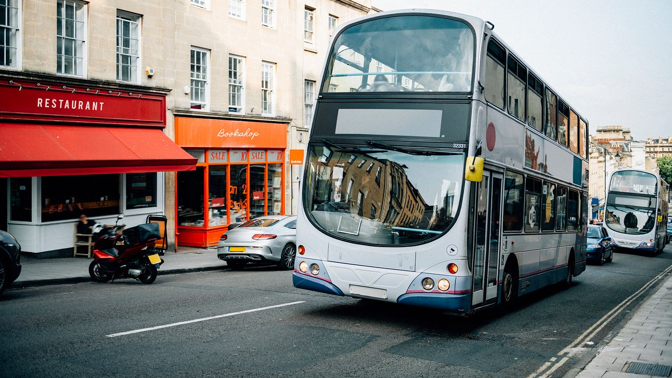
BUS TICKET BOOKING SYSTEM submitted by p. Prasanthi d. Surekha y. hemalatha
s

Slide 2

Contents :
Abstract
Problem statement
Solution
Scope
Requirements
Modules

Slide 3
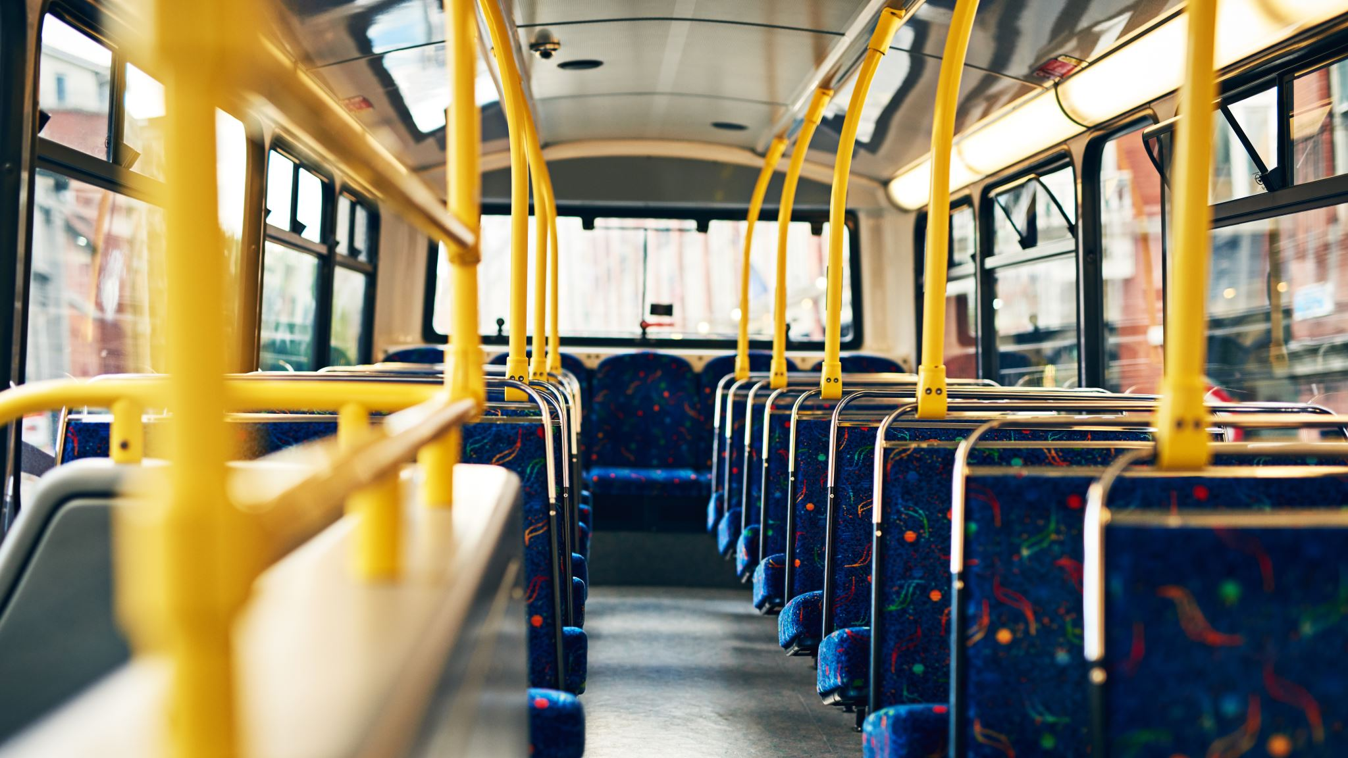
ABSTRACT :
The Bus Ticket Booking System is a Java-based application developed to automate the process of booking and cancelling bus tickets. The system provides a centralized, database-driven solution that manages bus routes, seat allocation, and booking records efficiently. By using JDBC for database operations, the system ensures accurate seat allocation, prevents duplicate bookings, and allows users to check real-time seat availability, making the ticket booking process faster and more reliable.

Slide 4
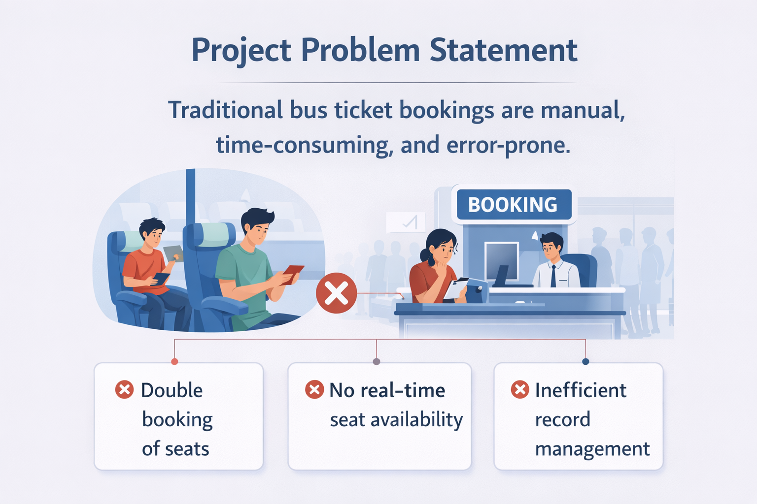
Problem Statement :
The traditional bus ticket booking process is often manual, time-consuming, and error-prone, leading to issues such as double booking of seats, lack of real-time seat availability, and inefficient record management. These limitations make the reservation process slow and unreliable, creating a need for an automated and efficient ticket booking system.

Slide 5
Solution :
The method to solve this problem is to create an online booking bus ticket system. This booking system aims to computerize and automate the process of booking and cancelling bus tickets by providing a centralized database-driven system that ensures accurate seat allocation, prevents duplicate bookings, and allows users to view real-time seat availability using JDBC-based database operations.

Slide 6

SCOPE :
User registration and login using Username and password
Viewing available bus routes
Displaying bus details
Checking real-time seat availability
Booking bus tickets
Cancelling booked tickets
Preventing duplicate seat booking
Managing booking records
Storing data in a MySQL database
JDBC-based connectivity between Java and database

Slide 7
Modules :
Route Management Module
Seat Availability Module
Ticket Booking Module
Ticket Cancellation Module
Database Management Module
User Interface Module

Slide 8
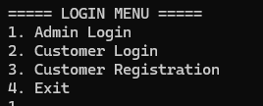
Login Menu
Admin Login: Admin enters username and password to access admin functions like adding buses, viewing bookings, and managing users.
Customer Login: Existing customers enter credentials to access booking and view their tickets.
Customer Registration: New customers can register with basic information like name, email, phone, and password.
Exit: Close the program.

Slide 9
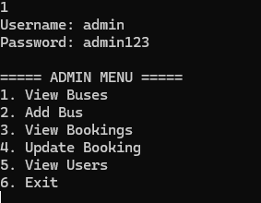
ADMIN MENU
View Buses: Admin can see all available buses, including bus ID, name, source, destination, total seats, and ticket price.
Add Bus: Admin can add a new bus to the system, specifying all details including ticket price.
View Bookings: Admin can view all booked tickets by all users, including booking ID, bus, user, travel date, seat number, and amount.
Update Booking: Admin can update seat numbers of any booking if needed.
View Users: Admin can see all registered users along with their role (admin/customer).
Exit: Return to login menu.

Slide 10
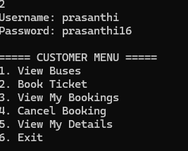
Customer Menu
View Buses: Customers can see all available buses along with details and ticket price.
Book Ticket: Customers can book a seat on a bus for a specific travel date. The system checks seat availability to prevent double booking.
View My Bookings: Customers can view all their booked tickets with bus, date, seat, and amount.
Cancel Booking: Customers can cancel their booking using the booking ID.
View My Details: Customers can see their registration details like ID, name, email, and phone.
Exit: Return to login menu.

Slide 11
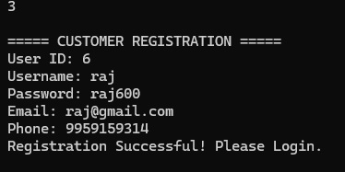
Customer Registration Module
The Customer Registration module allows new users to create an account in the Bus Reservation System.
The user enters details such as User ID, Username, Password, Email, and Phone Number.
These details are stored in the database using JDBC and SQL insert query.
After successful registration, the system displays the message “Registration Successful! Please Login.”
The customer can then log in to the system and book bus tickets.

Slide 12
THANK YOU

